Slide 1
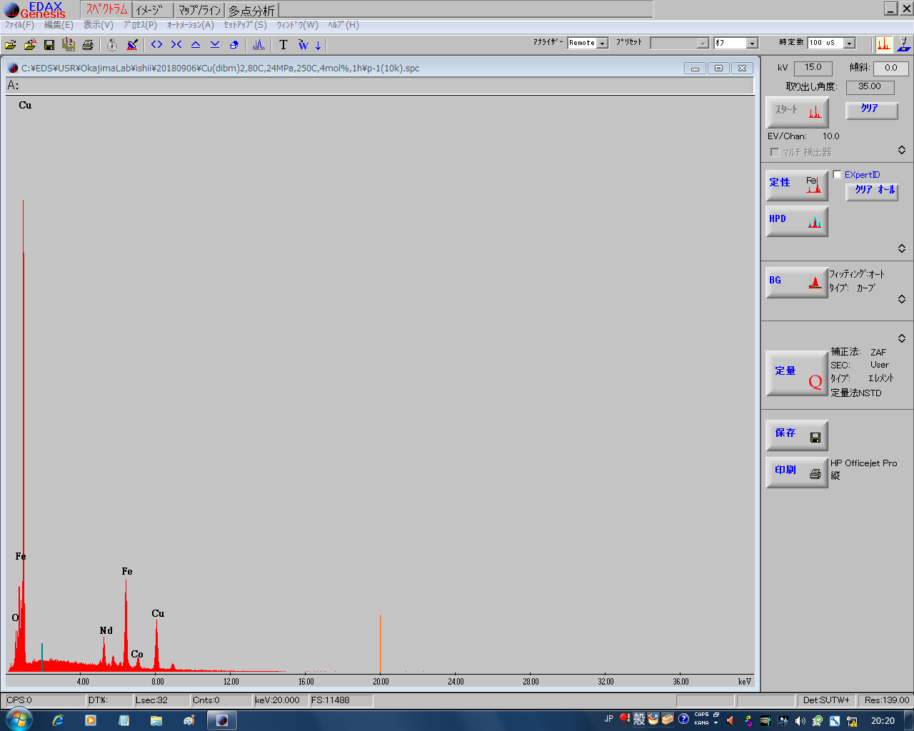
Spectrum/image/map and line/multi points
Time constant
②DT must be set between 20% and 30% by changing the time constant
①CPS must be set around 10,000 by changing the probe current
(In advance, you must switch off the power of the IR camera)
Fig. 1 Start up

Slide 2
①Select spectrum tab
④Start acquisition of spectrum
⑤wait 10 sec or more
⑥Repress this button to stop
Controller of the size and area of the spectrum
②Clear the previous spectrum
⑥ auto identification
③Clear the previous identification
Detail setting of identification
⑦Show the quantity
Fig. 2 Spectrum

Slide 3
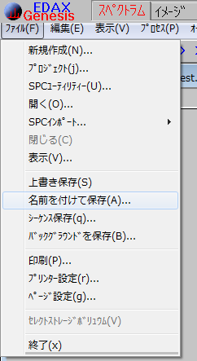
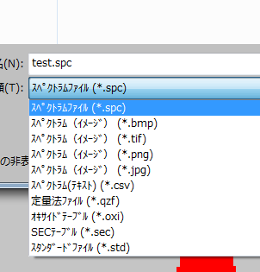
How to save spectrum in spectrum mode
Raw spectrum data
Save spectrum as graphic file
Save spectrum data as csv format

Slide 4
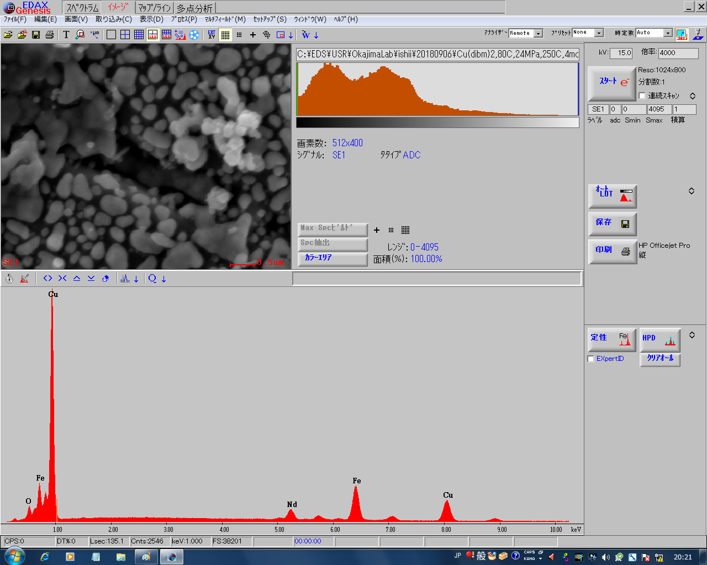
Change the arrangement of the sreen
①Select image tab
EXIT the SEM control by EDS
whole area/ limited area/point to be measured
④ Get SEM image
⑦ Auto identification
⑥ Show the quantity
②Clear the previous spectrum
Detail setting of identification
④Start acquisition of spectrum
⑤Wait 10 sec or more
⑥Repress this button to stop
③Clear the previous identification
Fig. 3 Image

Slide 5
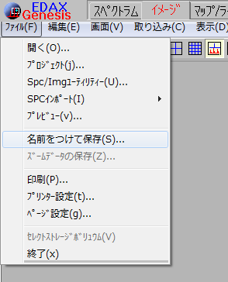
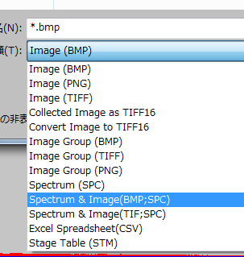
How to save spectrum in image mode
Save SEM image as graphic file
Raw spectrum data
Save SEM image and
spectrum raw file
NOT csv file of spectrum

Slide 6
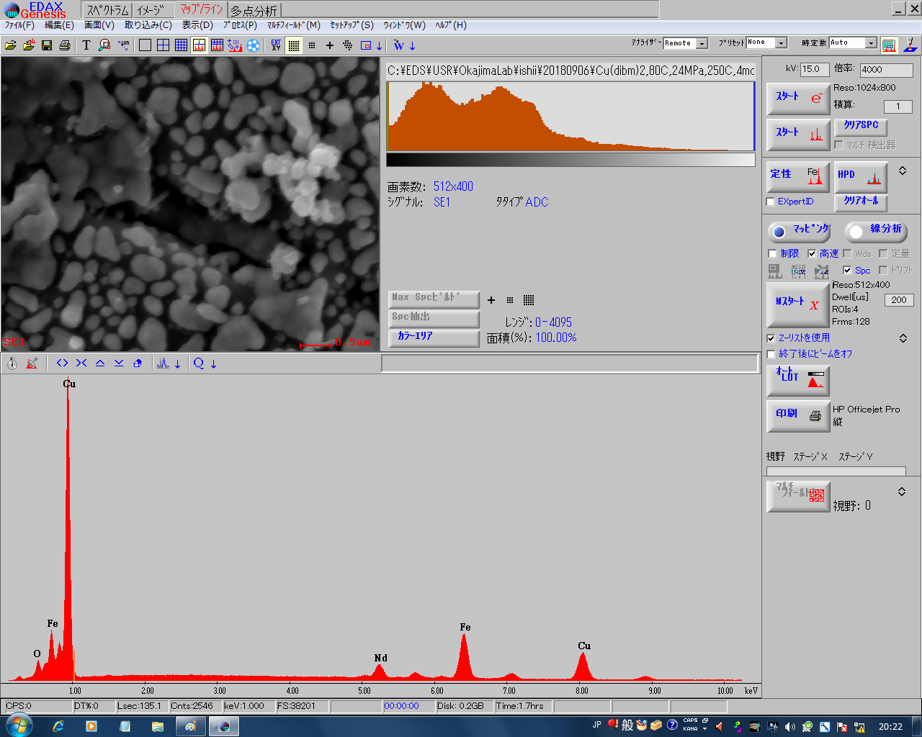
Arrange the displayed items
①Select map/line tab
EXIT the SEM control by EDS
④ Get SEM image
whole area/ limited area/point to be measured
②Clear the previous spectrum
⑧ Auto identification
Detail setting of identification
③Clear the previous identification
⑨Select mapping / line
⑩Start mapping / line
Show the quantity
②Clear the previous spectrum
⑤Start acquisition of spectrum
⑥Wait 10 sec or more
⑦Repress this button to stop
Fig. 4 mapping and line

Slide 7
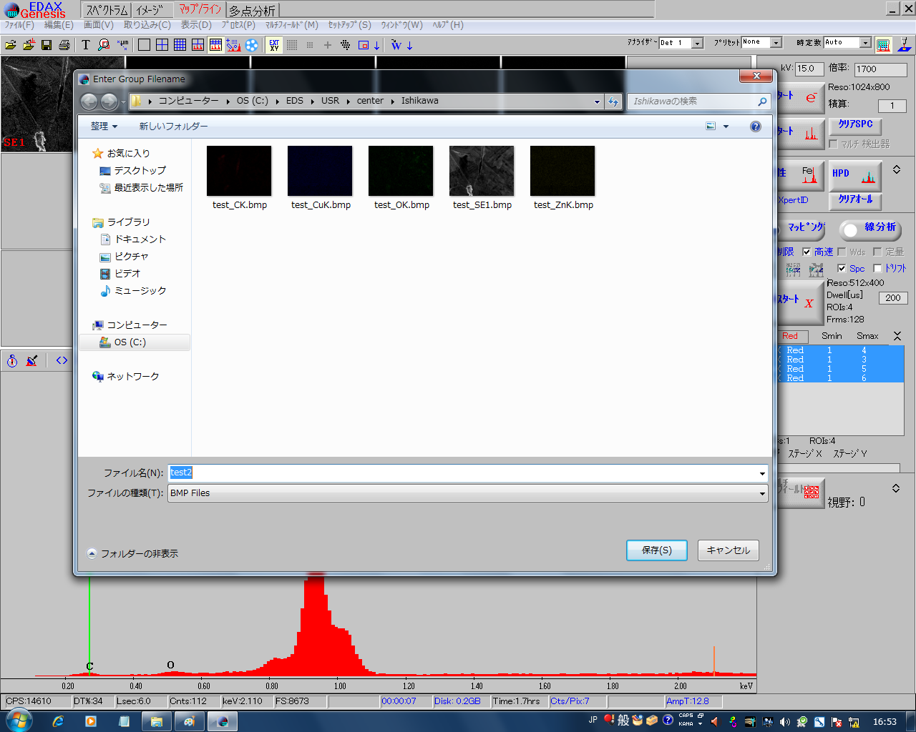
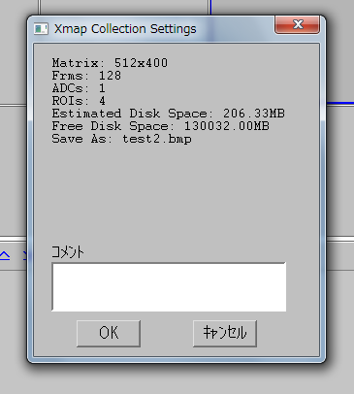
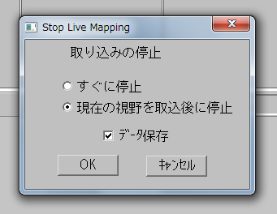
After M start button is pressed
Mapping measurment
①File save dialog opens.
Enter file name header.
Press 保存(S) button.
② Comment input dialog opens.
Enter the comment in text box.
Press OK button.
Repress the M start button to stop
Mapping immediately stops
Mapping stops after current scan finished
Make data file (Remove the check when you stop scan
by unexpected reason)
After stopping the scan, the data is saved automatically.

Slide 8
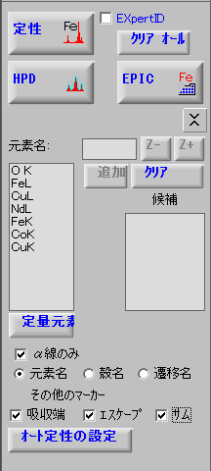
Detail setting of identification
Enter the name of element you want to add
Close the detail setting
Change the atomic number
delete the element from the element list
add the element from the candidate list
candidate list is shown when you indicate the any peaks on the spectrum
Identified elements list to be quantified or mapped
If checked, only α lines are displayed
Fig. 5 detail setting of identification

Slide 9
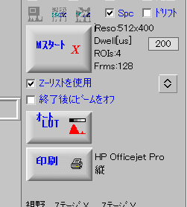
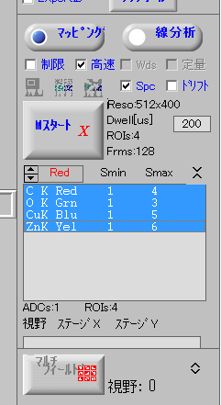
How to change the mapping color
①Remove this check
④Set this check
③Select new color
②Select the element
to be changed color
Press this to open the details
This process must be done in advance of the start of mapping

Slide 10
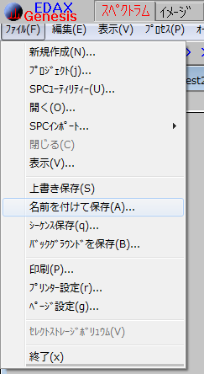
How to transfer raw spc file into csv file
① Select “spectrum Tab”
② Open saved csv file to be conversed.
③ ファイル(F) → 名前をつけて保存(A)
Raw spectrum data
Save spectrum as graphic file
Save spectrum data as csv format

